Slide 1
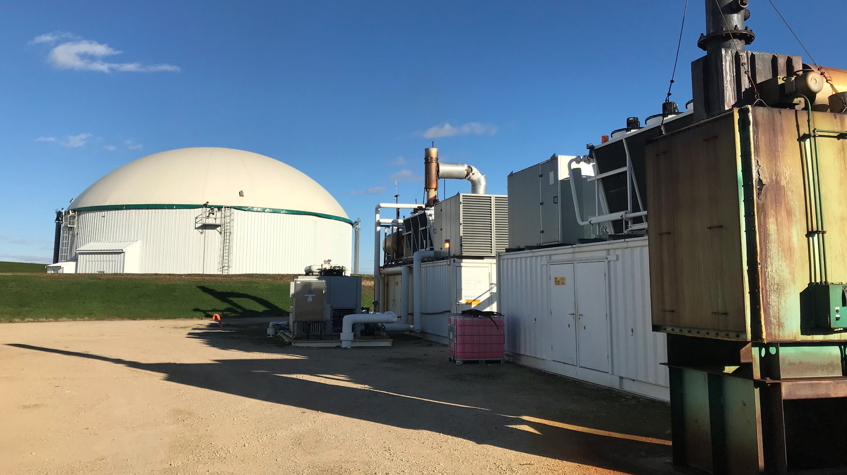
Status and Prospects of Biogas Industries in Wisconsin
Biogas: Putting the pieces together
Renewable Energy Summit, Jan. 14, 2021
Dr. Shiba Kar
Associate Professor &
Integrated Energy Extension Specialist
Center for Land Use Education
University of Wisconsin-Stevens Point
shiba.kar@uwsp.edu

Slide 2
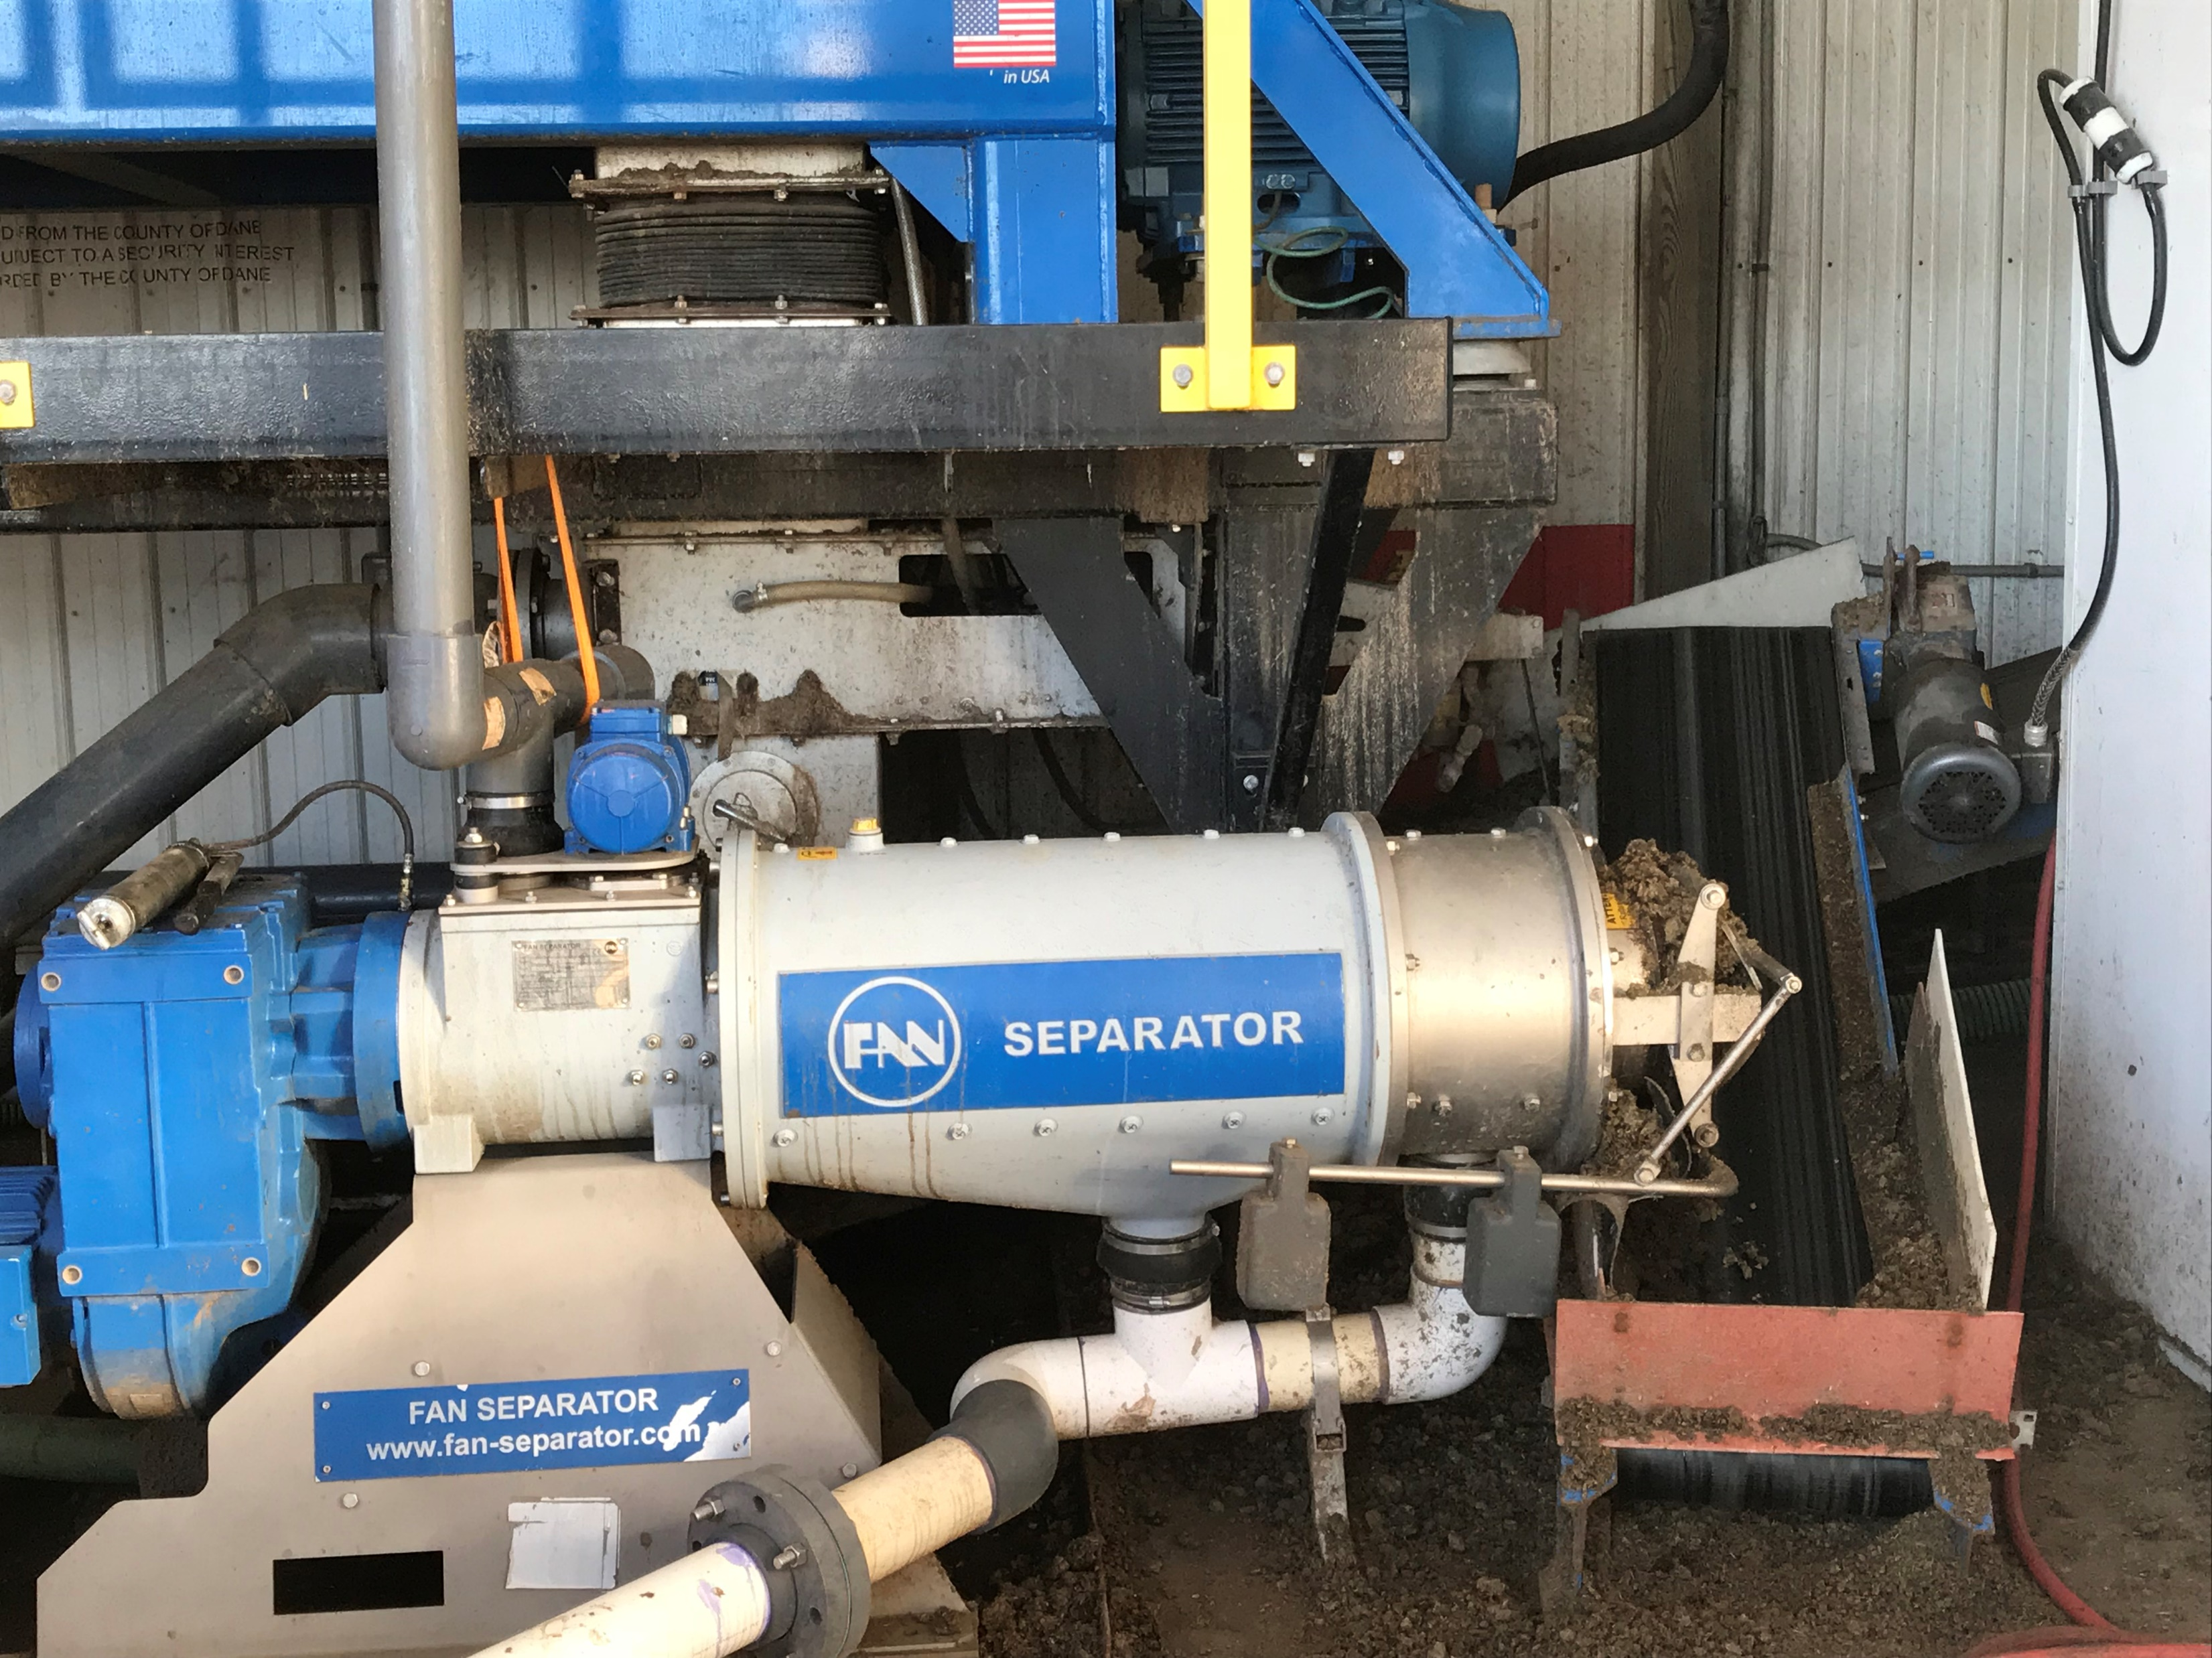
Biogas Feedstock and Industry Survey 2020
Objectives:
Explore and assess the status, barriers and challenges of biogas facilities in Wisconsin
Gain a better understanding of the biogas facilities to promote biogas production and use

Slide 3
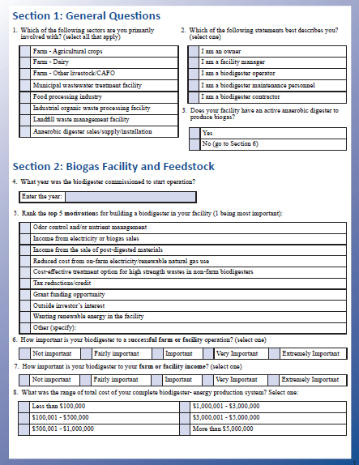
Study methods
Refined the biogas facility contact list
Feedback from other biogas experts
Pre-testing with a few biogas facilities
Electronic survey using Qualtrics
Printed Survey by mail
Data compilation, analysis and mapping
Develop a detailed report

Slide 4
Biogas facilities in Wisconsin

Slide 5
Preliminary Observations: Biogas Facility and Feedstock
Top motivation: Odor control and nutrient management
Range of total installation cost: $1 to 5 million
Grant funding received: mostly 10-30%
Primary feedstocks: Cow manure, municipal wastewater, industrial high strength wastewater, food waste

Slide 6
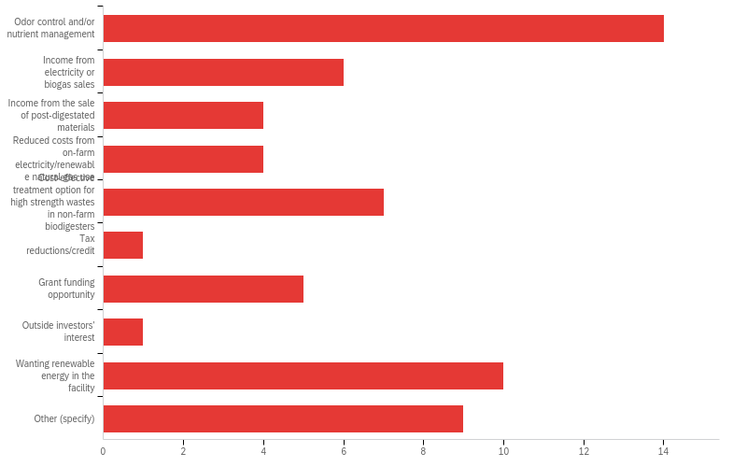
What are the top 5 motivations for building a biodigester in your facility?

Slide 7
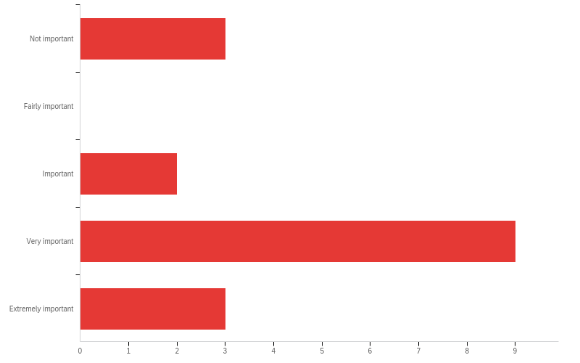
How important is your biodigester to a successful farm or facility operation?

Slide 8
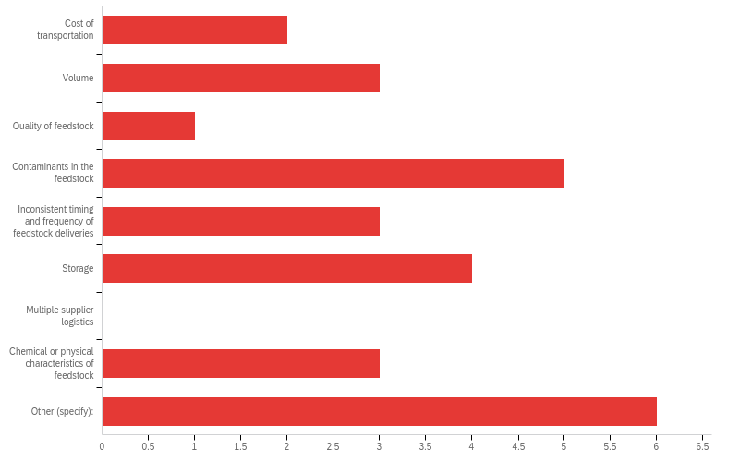
What are the challenges your facility faces with feedstock acquisition?

Slide 9
Preliminary Observations: Operations and Maintenance
Average number of staff: 5
Range of annual system operation cost: $20K to 200K
Top challenges:
Generator malfunction, variation in quality and quantity of biogas production, foaming

Slide 10
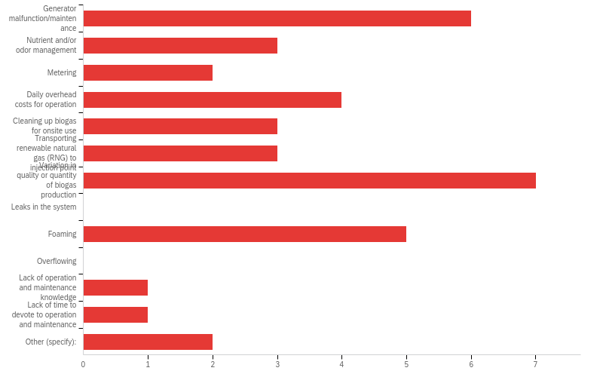
What are the top 5 challenges to your daily biodigester operation?

Slide 11
Preliminary Observations: Production and End use
Average daily biogas produced: 25,000 to 650,000 Cubic feet
End uses: Heat for process, facility heating, electricity, flare
Co-products:
Fertilizer, bedding for livestock, waste heat recovery, flush water

Slide 12
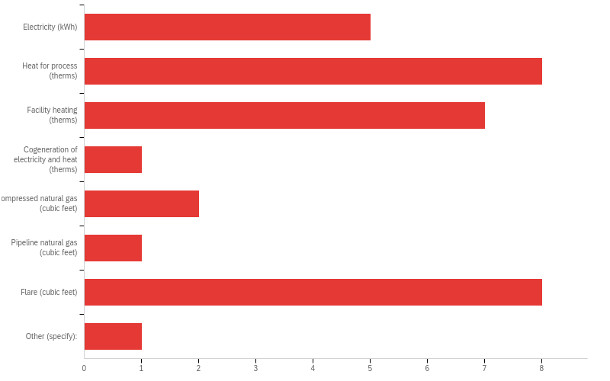
What is the end-use(s) of biogas produced at your facility?

Slide 13
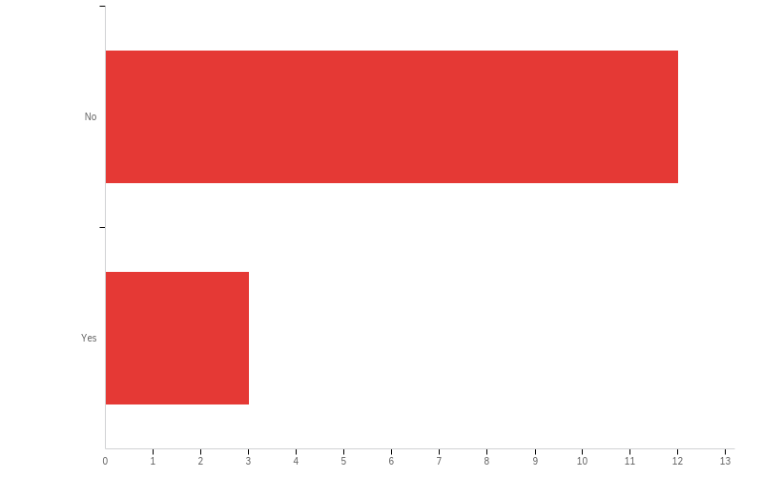
Does your facility currently have a pipeline to inject biogas to intra- or inter-state natural gas pipelines?

Slide 14
Preliminary Observations: Challenges and Policies
Top challenges in biodigester adoption:
Permitting, waste contract, generator commissioning, nutrient management regulation
Resources and assistance that were helpful:
Funding assistance, assistance from vendor/utility,
Top policies and practices that would be helpful:
More specific state and federal grants and incentives
Less stringent permitting
Higher price for renewable energy credits
Policy encouraging investors

Slide 15
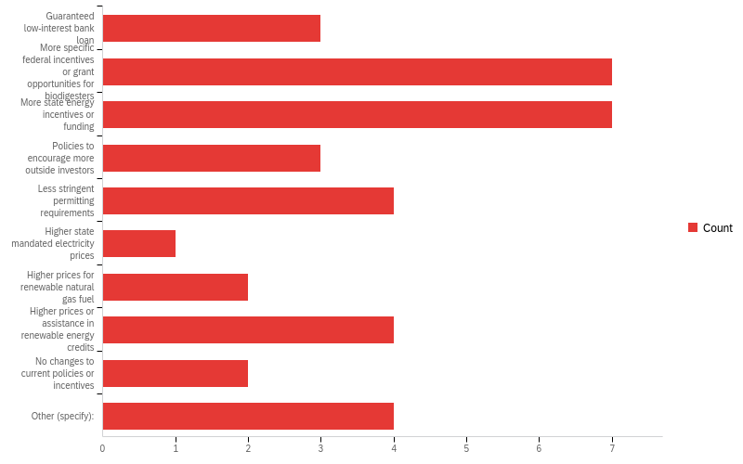
Top 5 policies or practices that would have been helpful?

Slide 16
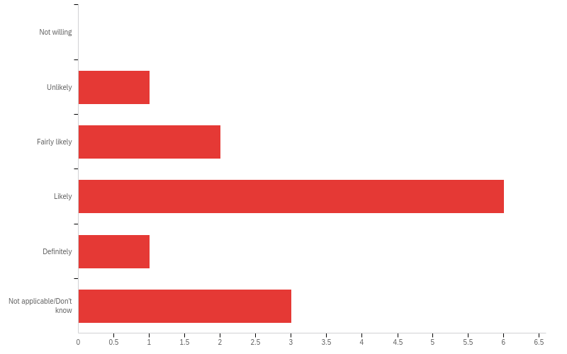
How likely would you be to invest in another digestion system in the future?

Slide 17
Biogas Factsheet
https://www.uwsp.edu/cnr-ap/clue/Pages/Biogas-in-WI.aspx

Slide 18
Thank you! Questions?
Email: shiba.kar@uwsp.edu

Slide 19
Do you have a Power Purchase Agreement (PPA) with a local utility?

Slide 20
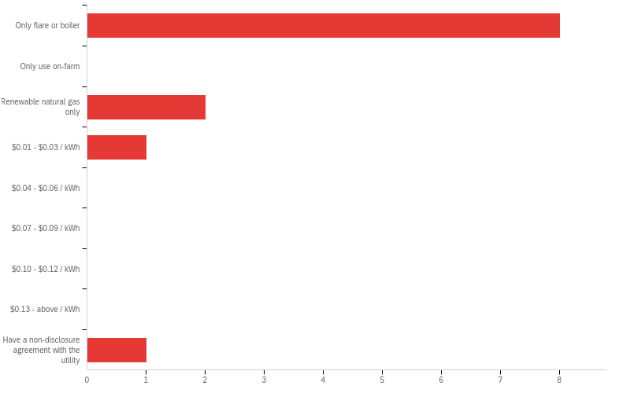
In 2020, what electricity rate did you get for electricity generated from your biodigester?

Slide 21
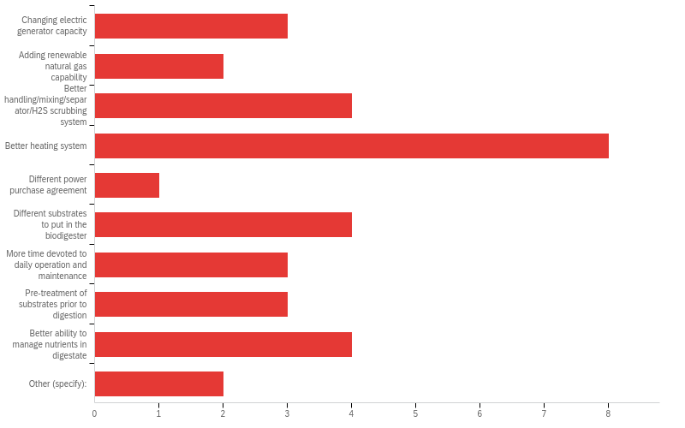
Top 5 changes you would make on your digestion system(s) if you had the resources?

Slide 22
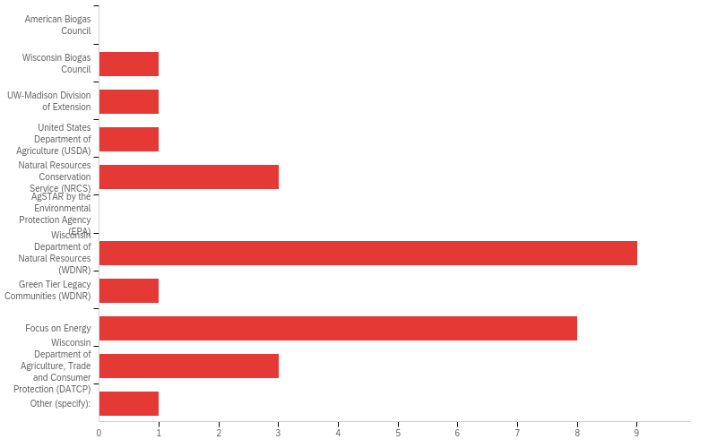
Does your facility or business currently have a membership or work with any of the following?

Slide 23
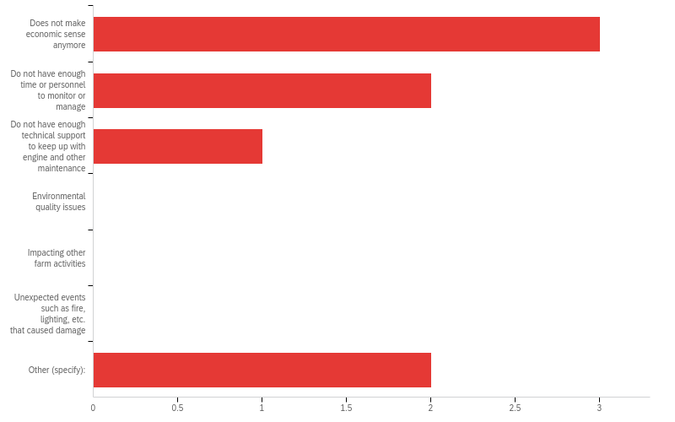
What are the reasons for not operating the biogas biodigester?

